Slide 1
8th Grade Science Chapter 11-2 Speed and Velocity

Slide 2
Learning Objectives
I can describe speed
I can describe velocity
I can explain the difference between speed and velocity

Slide 3
Speed
Speed is the rate at which an object moves or the ratio of the distance an object moves to the amount of time the object moves
Speed = $\frac{distance}{Time}$

Slide 4
2 Things you need to know to describe or calculate speed
distance
time

Slide 5
2 ways to express speed
Average speed – How far you traveled in a given amount of time. Computed for the entire duration of the trip.
Instantaneous Speed – Speed at that very moment in time

Slide 6
Formula Representation
Formula | Represents | Units
S = $\frac{d}{T}$ | S = | meters/second (m/s)
 | d = Distance | meters (m)
 | T = Time | Second (s)
Speed

Slide 7
Speed Related Equations
Speed | Distance | Time
S = $\frac{d}{t}$ | d = St | t = $\frac{d}{S}$

Slide 8
Average Speed
Average speed is the total distance divided by the total time.
Ave Speed = $\frac{Total distance}{Total Time}$
Reason used – Objects do not travel at a constant rate and gives you approximately how long the trip will take.

Slide 9
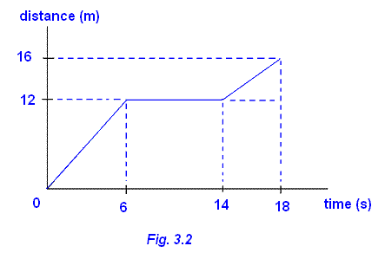
Average Speed
Not all objects move at constant speeds.
The average speed also uses the formula speed = total distance/ total time
Going to Columbus, you
change speeds during the
drive many times. So over
all you travel at an average
speed.

Slide 10
Velocity
Velocity is a vector
Velocity is speed in a given direction.
It is also determined by using the distance from the starting position to the ending position, rather than the distance of the path taken.

Slide 11
3 Things you need to know to describe or calculate velocity
Distance
Time
Direction

Slide 12
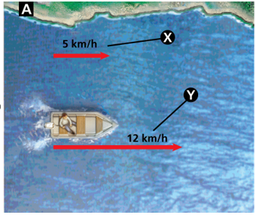
Combining Velocities by Vector addition
Same direction
12 km/hr + 5 km/hr =
17 km/hr

Slide 13
Combining Velocities by Vector addition
Opposite direction
12 km/hr - 5 km/hr =
7 km/hr

Slide 14
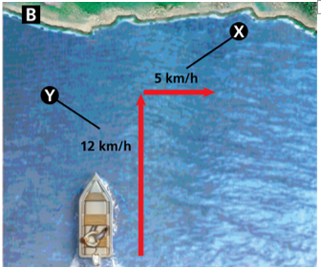
Combining Velocities by Vector addition
Right Angles
a² + b² = c²
12km/hr² + 5km/hr² = c²
144km/hr + 25km/hr = c²
169 = c²
C = 13km/hr

Slide 15
Combining Velocities by Vector addition
Same direction – add
Opposing/Opposite direction – Subtract
Right Angles – Pythagorean Theorem
- a² + b² = c²

Slide 16
Velocity
A runner moves eastward at 10m/s.
speed is 10m/s
velocity is 10m/s east
Velocity is very important for airplane pilots, weather forecasters and anyone driving from one place to another.

Slide 17
Big Ideas
Speed is the rate at which an object moves or the ratio of the distance an object moves to the amount of time the object moves.
Velocity is the speed in a given direction
- is a vector

Slide 18
Big Ideas
Combining Velocities by Vector Addiction
- Same direction – add
- Opposing/Opposite direction – Subract
- Right Angles – Pythagorean Theorem
- a² + b² = c²

